Slide 1
Module 3
Managing Active Directory Domain Services Objects
Notes:
Presentation: 75 minutes
Lab: 70 minutes
After completing this module, students should be able to:
Manage user accounts with graphical tools.
Manage groups with graphical tools.
Manage computer accounts.
Delegate permission to perform Active Directory® Domain Services (AD DS) administration.
Required Materials
To teach this module, you need the Microsoft® Office PowerPoint® file 20410D_03.pptx.
Important: We recommend that you use Office PowerPoint 2007 or a newer version to display the slides for this course. If you use PowerPoint Viewer or an older version of PowerPoint, all the features of the slides might not be displayed correctly.
Preparation Tasks
To prepare for this module:
Read all of the materials for this module.
Practice performing the demonstrations and lab exercises.
Work through the Module Review and Takeaways section, and determine how you will use this section to reinforce student learning and promote knowledge transfer to on‑the‑job performance.
20410D
3: Managing Active Directory Domain Services Objects

Slide 2
Module Overview
Managing User Accounts Managing Groups Managing Computer Accounts Delegating Administration
Notes:
Emphasize that managing users and computers has gotten much more complex with the proliferation of consumer devices in the workplace. Instead of just managing a relatively simple system of users and workstations, students may be managing multiple device types, operating systems, locations, multiple devices per user, various levels of access requirements, various levels of security depending on access level required, and many other factors.
20410D
3: Managing Active Directory Domain Services Objects

Slide 3
Lesson 1: Managing User Accounts
AD DS Administration Tools Creating User Accounts Configuring User Account Attributes Creating User Profiles Demonstration: Managing User Accounts Demonstration: Using Templates to Manage User Accounts
Notes:
One way to approach this lesson’s content is to focus on the demonstrations. Start the demonstrations, and then discuss the content in the topics as you proceed. This might take a couple of practices before you can perform the demonstrations without referring to the notes pages, but it makes the lesson a more engaging experience for students.
20410D
3: Managing Active Directory Domain Services Objects

Slide 4



AD DS Administration Tools
To manage AD DS objects, you can use the following graphical tools:
Active Directory Administration snap-ins
Active Directory Administrative Center
You can also use the following command-line tools:
Active Directory module in Windows PowerShell
Directory Service commands
C:/
Notes:
Consider demonstrating each tool as you discuss it.
20410D
3: Managing Active Directory Domain Services Objects

Slide 5
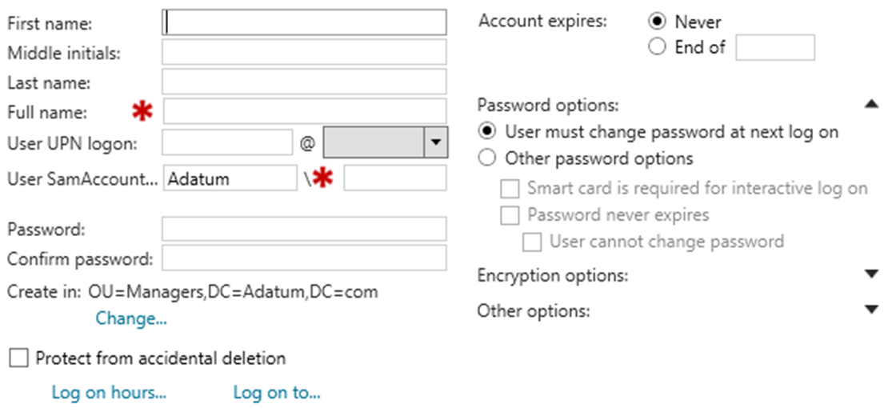
Creating User Accounts
The Account section of the Active Directory Administrative Center Create User window
Notes:
Consider performing a demonstration of creating a user account, by using the steps that the student handbook provides.
Discussion Prompt
Ask your students about their user account naming strategies.
20410D
3: Managing Active Directory Domain Services Objects

Slide 6
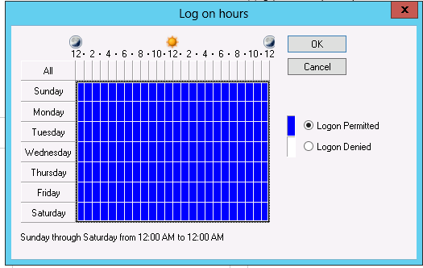
Configuring User Account Attributes
The Log on hours dialog box
Notes:
Consider opening users’ accounts and viewing their account properties as you discuss this content with students.
20410D
3: Managing Active Directory Domain Services Objects

Slide 7
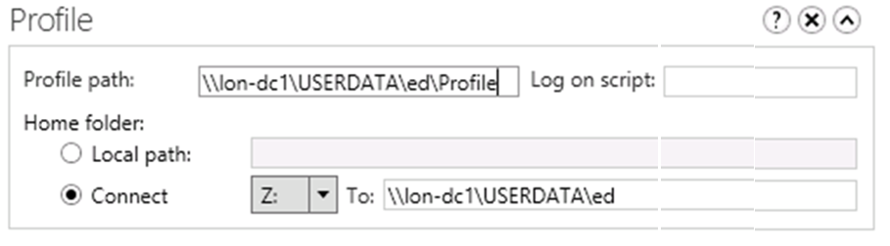
Creating User Profiles
The Profile section of the User Properties window
Notes:
Consider demonstrating this procedure while you discuss the content with your students.
20410D
3: Managing Active Directory Domain Services Objects

Slide 8
Demonstration: Managing User Accounts
In this demonstration, you will see how to:
Use the Active Directory Administrative Center to manage user accounts
Delete a user account
Create a new user account
Move the user account
View the WINDOWS POWERSHELL HISTORY
Use Windows PowerShell to manage user accounts
Find inactive user accounts
Find disabled user accounts
Delete disabled user accounts
Notes:
Discussion Prompt
When you discuss the content that precedes the demonstration steps, students might be interested in discussing how to communicate a password change to users. Ask your students how they currently do this, and have them think about other methods. Possible solutions include sending a text to their cell phones, sending an email to an alternate address such as a Microsoft Live account, or making a telephone call.
Windows PowerShell
If appropriate, mention to your students that they also can use Windows PowerShell® commands to perform common user administration tasks, such as resetting a user’s password, by using the Set‑ADAccountPassword command.
For example, the following command resets Amy‘s password:
Set ADAccountPassword ‑identity ‘cn=amy, ou=IT, dc=contoso, dc=com’ ‑Reset ‑NewPassword (ConvertTo SecureString ‑AsPlainText “Pa$$w0rd2” ‑Force)
To unlock a user account by using Windows PowerShell, you can use the following command:
Unlock ADAccount ‑identity ‘cn=amy strand, ou=IT, dc=contoso, dc=com’
To disable or enable a user account by using Windows PowerShell, type the following cmdlets at a Windows PowerShell prompt:
Enable ADAccount ‑identity <name>
Disable ADAccount ‑identity <name>
Preparation Steps
Start the required virtual machine, 20410D‑LON‑DC1.
20410D
3: Managing Active Directory Domain Services Objects
(More notes on the next slide)

Slide 9
Notes:
Demonstration Steps
Delete a user account
Sign in to LON‑DC1 as Adatum\Administrator with the password Pa$$w0rd.
On LON‑DC1, in Server Manager, click Tools.
Click Active Directory Administrative Center.
In the Active Directory Administrative Center, click Adatum (local), and then double‑click Managers.
In Managers, right‑click Ed Meadows, and then click Delete.
In the Delete Confirmation dialog box, click Yes.
Create a new user account
In the Action pane, click New, and then click User.
In the Create User dialog box, in Full name, type Ed Meadows.
In User UPN logon, type Ed.
In Password and Confirm password, type Pa$$w0rd, and then click OK.
Move the user account
Right‑click Ed Meadows, and then click Move.
Click the IT organizational unit (OU), and then click OK.
In the navigation pane, click Adatum (local).
In the results pane, double‑click IT.
Verify that Ed Meadow’s account is listed.
(More notes on the next slide)
20410D
3: Managing Active Directory Domain Services Objects

Slide 10
Notes:
View the WINDOWS POWERSHELL HISTORY
If you have not already done so, maximize Active Directory Administrative Center.
At the bottom of the Active Directory Administrative Center window, click WINDOWS POWERSHELL HISTORY to expand the history section.
Discuss the following commands and switches:
The Remove-ADObject command and the switches used with it to delete Ed Meadows.
The New-ADUser command and the switches used with it to recreate Ed Meadows.
The additional commands used to configure the Ed Meadows account.
The Move-ADObject command and the switches used with it to move Ed Meadows.
Close the Active Directory Administrative Center.
Find users who have not signed in during the last 30 days
On the taskbar, click the Windows PowerShell icon.
To create a variable to specify the past 30 days, type the following command, and then press Enter:
$logonDate = (get‑date).AddDays(‑30)
To find all the user accounts that have not signed in during the past 30 days, type the following command, and then press Enter:
Get‑ADUser ‑Filter{lastLogon ‑le $logonDate}
The results include nearly every account in the domain because most of the accounts have never signed in.
(More notes on the next slide)
20410D
3: Managing Active Directory Domain Services Objects

Slide 11
Notes:
Find and delete all disabled user accounts
To find all the disabled user accounts, type the following command, and then press Enter:
Get-ADUser ‑Filter{enabled ‑ne $True}
The results should list four accounts in the Sales OU and two system accounts in the Users container, Guest and krbtgt.
To delete the disabled user accounts in the Sales OU without being prompted for confirmation, type the following command, and then press Enter:
Get-ADUser ‑SearchBase "OU=Sales,DC=Adatum,DC=com" ‑Filter{enabled ‑ne $true} | Remove‑adobject ‑Confirm:$False
If this command runs successfully, there is no output.
To verify that the disabled accounts have been deleted, type the following command, and then press Enter:
Get-ADUser ‑Filter{enabled ‑ne $True}
The results should list the two system accounts in the Users container, Guest and krbtgt.
Leave the virtual machine running for the next demonstration.
20410D
3: Managing Active Directory Domain Services Objects

Slide 12
Demonstration: Using Templates to Manage User Accounts
In this demonstration, you will see how to:
Create a user template account
Use Windows PowerShell to create a user from the user template
Verify the properties of the new user account
Notes:
Discussion Prompt
Discuss the reasons for using template accounts. Typically, you use template accounts to save the time needed to fill out the properties on the user accounts. Explain that using Windows PowerShell to create users from a template copies only the specified properties. The properties that cannot be copied include the Member Of property. If you want to include the group memberships from a template, then you need to use either Active Directory Users and Computers or the Active Directory Administrative Center.
Reference:
For a full list of the properties that can be copied from a template for a new user, refer to "Copy a User's Properties" at http://go.microsoft.com/fwlink/?LinkID=331092.
Preparation Steps
Ensure that the required virtual machine, 20410D‑LON‑DC1, is running.
Demonstration Steps
Create a template account
On LON‑DC1, in Server Manager, click Tools, and then click Active Directory Administrative Center.
In the Active Directory Administrative Center, click Adatum (local), and then double‑click Sales.
In the Action pane, click New, and then click User.
In the Create User dialog box, in First name, type _LondonSales, in Last name, type Template.
In User UPN logon, type _LondonSales.
Select Protect from accidental deletion.
Under Organization, in Department, type Sales.
In Company, type A. Datum.
20410D
3: Managing Active Directory Domain Services Objects
(More notes on the next slide)

Slide 13
Notes:
In City, type London.
In Description, type London Sales users.
In the Member of section, click Add.
In Enter the object names to select, type Sales, and then click OK.
In the Create User _LondonSales Template dialog box, click OK.
Create a user from the _LondonSales template
In the Windows PowerShell window, create a variable ($LondonSales) to hold the _LondonSales properties by using the following command, and then press Enter:
$LondonSales = Get‑ADUser ‑Identity "_LondonSales" ‑Properties Department,Company,City
To create a new Sales user in the Sales OU, type the following command, and then press Enter:
New‑ADUser ‑Name "Dan Park" ‑SamAccountName "Dan" ‑Path "OU=Sales,DC=Adatum,DC=com" ‑AccountPassword (ConvertTo‑SecureString ‑AsPlaintext "Pa$$w0rd" ‑Force) ‑GivenName "Dan" ‑Surname "Park" ‑DisplayName "Dan Park" ‑Enabled $True ‑UserPrincipalName "Dan@Adatum.com" ‑ChangePasswordAtLogon $true ‑Instance $LondonSales
Verify the User Properties
In the Windows PowerShell window, type the following command, and then press Enter:
Get-ADUser –Identity “Dan” –Properties *
Verify that the properties that you defined in the template were copied to the new user.
Leave the virtual machine running for the next demonstration.
20410D
3: Managing Active Directory Domain Services Objects

Slide 14
Lesson 2: Managing Groups
Group Types Group Scopes Implementing Group Management Default Groups Special Identities Demonstration: Managing Groups
Notes:
Some students who are inexperienced with Windows Server often have difficulty grasping the concept of groups within groups. Consider using your whiteboard to go through the following example:
Draw three domains as triangles, and add a file resource to each domain.
Ask your students how many file permissions are required if each domain hosts 100 users who each need access to the three file resources in your three domains.
Group the three sets of 100 users, and repeat the question.
Group the groups, and repeat the question.
This elegantly demonstrates the benefit of nesting groups.
Now all you need to do is to explain the particulars of the types and scopes in Windows Server. As with Lesson 1, consider making the demonstration the focus of this lesson.
20410D
3: Managing Active Directory Domain Services Objects

Slide 15




Group Types
Distribution groups
Used only with email applications
Not security-enabled (no SID); cannot be given permissions
Security groups
Security principal with a SID; can be given permissions
Can also be email-enabled
Both security groups and distribution groups can be converted to the other type of group
Notes:
Explain to students that they can use distribution groups to send email messages to collections of users, but only with messaging programs such as Microsoft Exchange Server. Stress that distribution lists are not security-enabled, so they cannot be listed in discretionary access control lists (DACLs).
Also explain to students that they can use security groups to assign rights and permissions to both groups of users and groups of computers. A security group is security-enabled, and you can use it to assign permissions to local and network resources.
20410D
3: Managing Active Directory Domain Services Objects

Slide 16
Group Scopes
Group scope | Members from same domain | Members from domain in same forest | Members from trusted external domain | Can be assigned permissions to resources
Local | U, C, GG, DLG, UG and local users | U, C, GG, UG | U, C, GG | On the local computer only
Domain-local | U, C, GG, DLG, UG | U, C, GG, UG | U, C, GG | Anywhere in the domain
Universal | U, C, GG, UG | U, C, GG, UG | N/A | Anywhere in the forest
Global | U, C, GG | N/A | N/A | Anywhere in the domain or a trusted domain
U User C Computer GG Global group DLG Domain-local group UG Universal group
Notes:
Use the table to describe group scopes. Consider drawing a diagram with several domains that shows where you can create groups, and the implications of each group scope.
20410D
3: Managing Active Directory Domain Services Objects

Slide 17
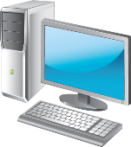

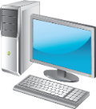

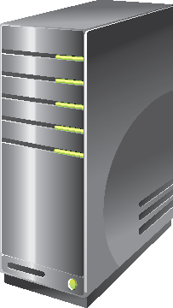

Implementing Group Management
I
Identities
Users or computers,
which are members of
Global groups
Which collect members based on members’ roles,
which are members of
Sales
(Global group)
G
Auditors
(Global group)
ACL_Sales_Read (Domain-local group)
DL
Domain-local groups
Which provide management
such as resource access,
which are
A
Assigned access to a resource
This best practice for nesting groups is known as IGDLA.
Notes:
This slide and the next five explain the example in the student notes. This slide summarizes the example, and the next five slides build up the example frame by frame. The five frames are:
Identities
Global groups
Domain-local groups
Assigned resource access
A copy of the summary, as shown in the first slide above
Alternatively, draw an illustration on the whiteboard by using the following guidelines to illustrate the advantage of group nesting:
Draw three domain objects, each containing five users. Draw a file object in one of the three domains.
Question: How many file permissions do you need to create to assign permissions on this file for each user?
Answer: You need to create 15 file permissions.
Draw a circle around the five users in each domain, and explain that the circles represent global groups.
Question: How many permissions on the file do you need to assign at the global group level?
Answer: You need to assign three permissions.
Draw a circle adjacent to the file. Draw arrows from your global groups to this circle, indicating that you have added these groups to a local group in the resource holding domain.
Question: How many permissions must you assign to the local group?
Answer: You must assign one permission to the local group.
20410D
3: Managing Active Directory Domain Services Objects

Slide 18
Implementing Group Management
I
Identities
Users or computers,
which are members of
Notes:
This is the 1st of 5 frames.
Identities are assigned to users or groups.
20410D
3: Managing Active Directory Domain Services Objects

Slide 19
Implementing Group Management
I
Identities
Users or computers,
which are members of
Global groups
Which collect members based on members’ roles,
which are members of
Sales
(Global group)
G
Auditors
(Global group)
Notes:
This is the 2nd of 5 frames.
The users and computers have been collected into two separate groups, the Sales (global group) and the Auditors (global group).
20410D
3: Managing Active Directory Domain Services Objects

Slide 20
Implementing Group Management
I
Identities
Users or computers,
which are members of
G
Global groups
Which collect members based on members’ roles,
which are members of
Sales
(Global group)
Auditors
(Global group)
ACL_Sales_Read (Domain-local group)
DL
Domain-local groups
Which provide management
such as resource access,
which are
Notes:
This is the 3rd of 5 frames.
The two global groups have been combined into one domain local group, which is called ACL_Sales_Read.
20410D
3: Managing Active Directory Domain Services Objects

Slide 21
Implementing Group Management
I
Identities
Users or computers,
which are members of
G
Sales
(Global group)
Global groups
Which collect members based on members’ roles,
which are members of
Auditors
(Global group)
ACL_Sales_Read (Domain-local group)
DL
Domain-local groups
Which provide management
such as resource access,
which are
A
Assigned access to a resource
Notes:
This is the 4th of 5 frames.
The domain-local group has been given access to a resource.
20410D
3: Managing Active Directory Domain Services Objects

Slide 22
Implementing Group Management
I
Identities
Users or computers,
which are members of
G
Sales
(Global group)
Global groups
Which collect members based on members’ roles,
which are members of
Auditors
(Global group)
ACL_Sales_Read (Domain-local group)
DL
Domain-local groups
Which provide management
such as resource access,
which are
A
Assigned access to a resource
This best practice for nesting groups is known as IGDLA
Notes:
This is the 5th of 5 frames.
This is a summary of the example. It is the same as the slide in the Student Manual.
20410D
3: Managing Active Directory Domain Services Objects

Slide 23
Default Groups
Carefully manage the default groups that provide administrative privileges, because these groups:
Typically have broader privileges than are necessary for most delegated environments
Often apply protection to their members
Group | Location
Enterprise Admins | Users container of the forest root domain
Schema Admins | Users container of the forest root domain
Administrators | Built-in container of each domain
Domain Admins | Users container of each domain
Server Operators | Built-in container of each domain
Account Operators | Built-in container of each domain
Backup Operators | Built-in container of each domain
Print Operators | Built-in container of each domain
Cert Publishers | Users container of each domain
Notes:
Show your students the groups mentioned on the slide as you discuss them.
20410D
3: Managing Active Directory Domain Services Objects

Slide 24
Special Identities
Special identities:
Are groups for which membership is controlled by the operating system
Can be used by the Windows Server operating system to provide access to resources:
Based on the type of authentication or connection
Not based on the user account
Important special identities include:
Anonymous Logon Authenticated Users Everyone | Interactive Network Creator Owner
Notes:
Show your students the identities that are mentioned on the slide, as you discuss them.
20410D
3: Managing Active Directory Domain Services Objects

Slide 25
Demonstration: Managing Groups
In this demonstration, you will see how to:
Create a new group
Add members to the group
Add a user to the group
Change the group type and scope
Modifying the group’s Managed By property
Notes:
Preparation Steps
The required virtual machine, 20410D‑LON‑DC1, should be running after the previous demonstration.
Demonstration Steps
Create a new group
On LON‑DC1, switch to Active Directory Administrative Center.
Expand Adatum (Local), and then click IT.
In the Tasks list, under IT, point to New, and then click Group.
In the Create Group dialog box, in Group name, type IT Managers.
Add members to the group
Scroll down, and under Members, click Add.
In the Select Users, Contacts, Computers, Service Accounts, or Groups dialog box, in Enter the object names to select (examples), type April; Don.
Click Check Names, and then click OK.
In the Create Group IT Managers dialog box, click OK.
Add a user to the group
In the details pane, right‑click Ed Meadows.
Click Add to group.
In the Select Groups dialog box, in Enter the object names to select (examples), type IT Managers.
Click Check Names, and then click OK.
20410D
3: Managing Active Directory Domain Services Objects
(More notes on the next slide)

Slide 26
Notes:
Change the group type and scope
In the details pane, double‑click IT Managers.
In the IT Managers dialog box, under Group scope, click Universal.
Under Group type, click Distribution, and then click OK.
Modify the group’s Managed By property
In the details pane, double‑click IT Managers.
In the details pane, under Managed By, click Edit.
In the Select User, Contact or Groups dialog box, in Enter the object names to select (examples), type Ed Meadows, click Check Names, and then click OK.
Select Manager can update membership list, and then click OK.
Leave the virtual machine running for the next demonstration.
20410D
3: Managing Active Directory Domain Services Objects

Slide 27
Lesson 3: Managing Computer Accounts
What Is the Computers Container? Specifying the Location of Computer Accounts Controlling Permissions to Create Computer Accounts Performing an Offline Domain Join Computer Accounts and Secure Channels Resetting the Secure Channel Bring Your Own Device
Notes:
There are no demonstrations in this lesson. As you proceed through the content, consider performing small, impromptu demonstrations to help reinforce the content.
20410D
3: Managing Active Directory Domain Services Objects

Slide 28
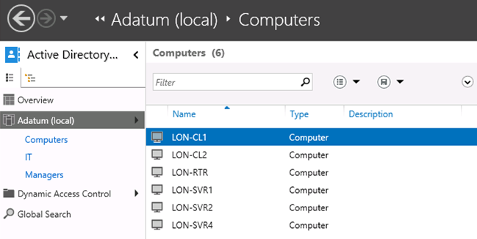
What Is the Computers Container?
Active Directory Administrative Center, opened to the Adatum (local)\Computers container
Distinguished Name is cn=Computers,DC=Adatum,DC=com
Notes:
Consider opening Active Directory Users and Computers or Active Directory Administrative Center and demonstrating the default location for computer objects.
Explain that the Distinguished Name “cn=Computers,DC=Adatum,DC=com” provides a full description of the Computers object. The common named object (cn) Computers is a container located in the domain component (DC) Adatum, which is in the domain component named com.
20410D
3: Managing Active Directory Domain Services Objects

Slide 29
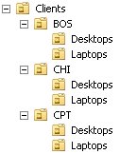
Specifying the Location of Computer Accounts
Best practice is to create OUs for computer objects
Servers
Typically subdivided by server role
Client computers
Typically subdivided by region
Divide OUs:
By administration
To facilitate configuration with Group Policy
Notes:
Emphasize the best practice of creating custom OUs for computer objects, rather than relying on the default Computers container.
Help students understand just enough about delegation (assigning permissions to OUs) and about configuration (linking GPOs to OUs) to understand how they might choose to design OU branches for clients and servers. Later modules go into more detail about Group Policy and delegation, and their impact on OU design. Do not go into too much detail here, but rather use the opportunity to introduce students to these concepts.
20410D
3: Managing Active Directory Domain Services Objects

Slide 30
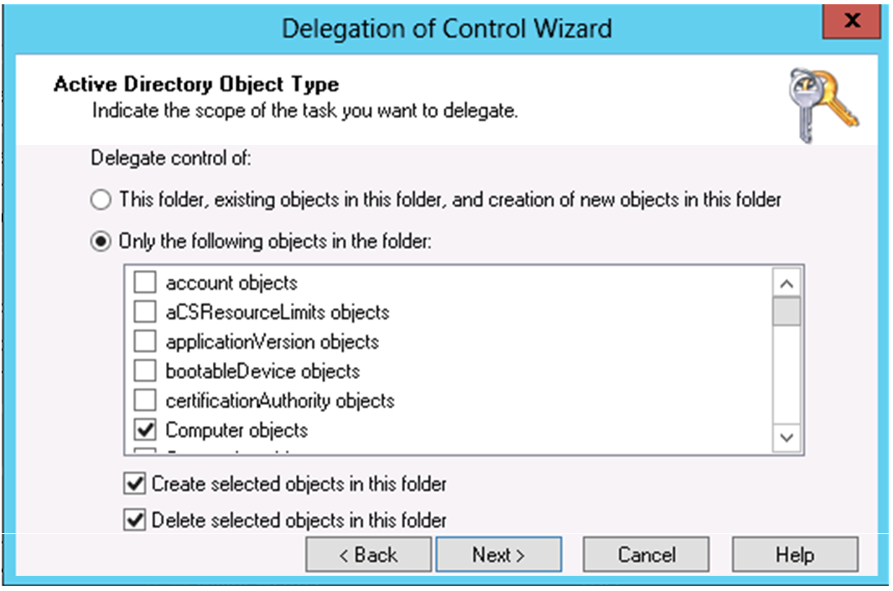
Controlling Permissions to Create Computer Accounts
The Delegation of Control Wizard window
The administrator is creating a custom delegation for computer objects
Notes:
Consider demonstrating the process of delegating control over computer creation and deletion.
20410D
3: Managing Active Directory Domain Services Objects

Slide 31
Performing an Offline Domain Join
Offline domain join is used to join computers to a domain when they cannot contact a domain controller
Create a domain join file using:
Import the domain join file using:
djoin.exe /Provision /Domain <DomainName> /Machine <MachineName> /SaveFile <filepath>
djoin.exe /requestODJ /LoadFile <filepath> /WindowsPath <path to the Windows directory of the offline image>
Notes:
Explain that offline domain join was introduced to help with joining computers to the domain over unreliable connections. In Windows 8 and Windows Server 2012, domain join was expanded to include the DirectAccess feature. This enables computers to join the domain without communicating with a domain controller; and once the DirectAccess settings are applied, the computers can interact with the domain through any Internet connection.
Discuss the scenarios for offline domain join. Ask students how they might use this feature in their own environments. Students from organizations that do not have branch offices will find this feature less useful than students from organizations that have remote branches.
20410D
3: Managing Active Directory Domain Services Objects

Slide 32
Computer Accounts and Secure Channels
Computers have accounts
sAMAccountName and password
Used to create a secure channel between the computer and a domain controller
Scenarios in which a secure channel can be broken
Reinstalling a computer, even with same name, generates a new SID and password
Restoring a computer from an old backup, or rolling back a computer to an old snapshot
Computer and domain disagree about what the password is
Notes:
Explain that the secure channel between a computer and a domain controller is used for all communication with the domain, including user sign-in authentication to the computer. The secure channel is established when the computer authenticates to the domain by using its user name and password. Like users, computers have sign-in names and passwords. If the computer is unable to sign in successfully, the secure channel is not established. The effect is similar to when a user enters the wrong user name or password. In both circumstances, the user is not able to authenticate to the domain.
There are several scenarios during which the secure channel can be broken. Three of these are listed on the slide.
The slide does not list Administrator errors in AD DS. These can include dangerous Active Directory actions, such as rolling back a domain controller that is running a snapshot. You should mention that there are several ways for an administrator to damage AD DS (manually, automatically, intentionally, or accidentally), and damage might become apparent when broken secure channels appear.
Discussion Prompt
Ask students:
What scenarios have you encountered in which you identified that the secure channel was broken?
How did you know the secure channel was broken?
After students have shared their experiences, ask the question a slightly different way:
What scenarios have caused you to remove a computer from the domain, and then rejoin it to the domain?
This is a very common technique that administrators use to reset a secure channel. They often do not realize what they are actually doing when they remove the computer and then rejoin the domain.
If students have not already mentioned the sign-in message that states, “The trust relationship between the workstation and the primary domain failed,” ask students the following question:
Have you ever tried to sign in to the domain and received a message telling you that the computer could not talk to the domain? What messages did you receive?
Help students delineate messages such as “A domain controller is not available,” which is typically the result of networking connectivity problems, from messages that mention trust with the domain or otherwise indicate problems with the secure channel.
The following topic discusses the steps to take when one of these scenarios happens.
20410D
3: Managing Active Directory Domain Services Objects

Slide 33
Resetting the Secure Channel
Do not delete a computer from the domain and then rejoin it
This creates a new account, resulting in a new SID and lost group memberships
Options for resetting the secure channel
Active Directory Users and Computers
Active Directory Administrative Center
dsmod
netdom
nltest
Windows PowerShell
Notes:
A broken computer account manifests itself with a variety of symptoms, error messages, and event‑log entries.
Mention that users might be able to sign in to a machine with a broken secure channel by using cached credentials, but they will experience other strange behavior, because authentication cannot use Kerberos version 5 (V5) protocol without a functioning secure channel.
Because nltest and netdom reset the secure channel without requiring a reboot, you should try those commands first. If you are not successful with those two commands, only then should you use dsmod, or the Reset Account selection in Active Directory Users and Computers or Active Directory Administrative Center to reset the computer account.
Resetting the secure channel requires the Reset Password permission on the computer object.
20410D
3: Managing Active Directory Domain Services Objects

Slide 34
Bring Your Own Device
AD FS has been enhanced to support BYOD programs
Workplace Join creates an AD DS object for consumer devices
Limit content access to specific devices
Using Dynamic Access Control or conditions on permissions you can limit content access to domain-joined devices
Support for iOS
iOS devices can be workplace-joined as well
Notes:
This topic is a high-level overview of the new features in Windows Server 2012 R2 that help support consumer devices in a bring-your-own-device scenario.
20410D
3: Managing Active Directory Domain Services Objects

Slide 35
Lesson 4: Delegating Administration
Considerations for Using Organizational Units AD DS Permissions Effective AD DS Permissions Demonstration: Delegating Administrative Permissions
Notes:
Consider starting the demonstration topic, and then discussing the content in the other three topics. Start the lesson by asking your students to consider at what point a single administrator is unable to manage a network alone, and how best to allocate administrative tasks to other administrators.
20410D
3: Managing Active Directory Domain Services Objects

Slide 36
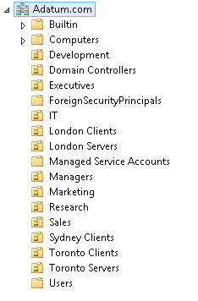
Considerations for Using Organizational Units
OUs allow you to subdivide the domain for management purposes
OUs are used for:
Delegation of control
Application of GPOs
The OU structure can be:
Flat, one to two levels deep
Deep, more than 5 levels deep
Narrow, anything in between
Notes:
Discuss the design of an organizational unit (OU) hierarchy. Discuss your experience with OU design, and students’ environments and the reasons they have created OUs. Explain that you should create OUs with a specific management goal in mind, with ease of management as a goal.
20410D
3: Managing Active Directory Domain Services Objects

Slide 37
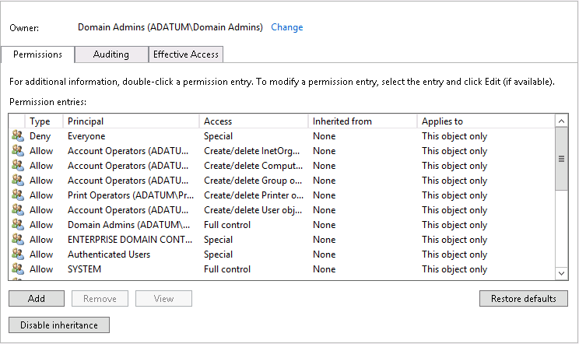
AD DS Permissions
Advanced Security Settings for IT
Notes:
Consider demonstrating the process of viewing permissions.
20410D
3: Managing Active Directory Domain Services Objects

Slide 38
Effective AD DS Permissions
Permissions assigned to users and groups accumulate
Best practice is to assign permissions to groups, not to individual users
In the event of conflicts:
Deny permissions override Allow permissions
Explicit permissions override Inherited permissions
Explicit Allow overrides Inherited Deny
To evaluate effective permissions, you can use:
The Effective Access tab
Manual analysis
Notes:
Consider demonstrating the process of viewing effective permissions.
20410D
3: Managing Active Directory Domain Services Objects

Slide 39
Demonstration: Delegating Administrative Permissions
In this demonstration, you will see how to:
Create an OU
Move objects into an OU
Delegate a standard task
Delegate a custom task
View AD DS permissions resulting from these delegations
Notes:
Discussion Prompt
You can manage delegation of control in Active Directory Domain Services (AD DS) either manually or by using the Delegation of Control Wizard. If you have a complex permission scenario, you may need to configure the permissions manually, but it is usually easier to assign permissions in AD DS by using the Delegation of Control Wizard.
Preparation Steps
The required virtual machine, 20410D‑LON‑DC1, should be running after the previous demonstration.
Demonstration Steps
Create an OU
On LON‑DC1, in Server Manager, click Tools, and then click Active Directory Users and Computers.
Expand the Adatum.com domain.
Right click Adatum.com, point to New, and then click Organizational Unit.
In the New Object – Organizational Unit dialog box, in Name, type Executives.
Note: Discuss the purpose of the Protect Container From Accidental Deletion setting.
In the New Object – Organizational Unit dialog box, click OK.
Move users into the Executives OU
Click the Managers OU.
Click Carol Troup, and then hold down Shift while clicking Euan Garden.
Right click Euan Garden, and then click Move.
In the Move dialog box, click Executives, and then click OK.
20410D
3: Managing Active Directory Domain Services Objects
(More notes on the next slide)

Slide 40
Notes:
Delegate a standard task
In the navigation pane, right‑click Executives, and then click Delegate Control.
In the Delegation of Control Wizard, click Next.
On the Users or Groups page, click Add.
In the Select Users, Computers, or Groups dialog box, in Enter the object names to select (examples), type IT, and then click OK.
On the Users or Groups page, click Next.
On the Tasks to Delegate page, in the Delegate the following common tasks list, select the following options, and then click Next
Create, delete, and manage user accounts,
Reset user passwords and force password change at next logon,
Read all user information
On the Completing the Delegation of Control Wizard page, click Finish.
Delegate a custom task
In the navigation pane, right‑click Executives, and then click Delegate Control.
In the Delegation of Control Wizard, click Next.
On the Users or Groups page, click Add.
In the Select Users, Computers, or Groups dialog box, in Enter the object names to select (examples), type IT, and then click OK.
On the Users or Groups page, click Next.
On the Tasks to Delegate page, click Create a custom task to delegate, and then click Next.
On the Active Directory Object Type page, click Only the following objects in the folder.
In the list, select Computer objects.
Select Create selected objects in this folder and Delete selected objects in this folder, and then click Next.
(More notes on the next slide)
20410D
3: Managing Active Directory Domain Services Objects

Slide 41
Notes:
On the Permissions page, in the Permissions list, select Full Control, and then click Next.
On the Completing the Delegation of Control Wizard page, click Finish.
View AD DS permissions resulting from these delegations
On the View menu, click Advanced Features.
In the navigation pane, right‑click Executives, and then click Properties.
In the Executives Properties dialog box, on the Security tab, click Advanced.
In the Advanced Security Settings for Executives dialog box, notice the Allow permissions that are assigned to IT (ADATUM\IT). These were created during the delegation process.
Click Cancel twice, and then close all open windows except Server Manager.
After you complete the demonstration, revert all virtual machines.
20410D
3: Managing Active Directory Domain Services Objects

Slide 42
Lab: Managing Active Directory Domain Services Objects
Exercise 1: Delegating Administration for a Branch Office Exercise 2: Creating and Configuring User Accounts in AD DS Exercise 3: Managing Computer Objects in AD DS
Logon Information
Virtual machines 20410D‑LON‑DC1
20410D‑LON‑CL1
User name Adatum\Administrator
Password Pa$$w0rd
Estimated Time: 70 minutes
Notes:
Before students begin the lab, read the lab scenario and display the next slide. Before each exercise, read the scenario associated with the exercise to the class. The scenarios give context to the lab and exercises, and help to facilitate the discussion at the end of the lab. Remind students to complete the discussion questions after the last lab exercise.
Exercise 1: Delegating Administration for a Branch Office
A. Datum delegates management of each branch office to a specific group. This allows an employee who works onsite to be configured as an administrator when required. Each branch office has a branch administrators group that can perform full administration within the branch office OU. There is also a branch office help desk group that is able to manage users in the branch office OU, but not other objects. You need to create these groups for the new branch office and delegate permissions to the groups.
Exercise 2: Creating and Configuring User Accounts in AD DS
You have a list of new users for the branch office, and you need to create user accounts for them.
Exercise 3: Managing Computer Objects in AD DS
A workstation has lost its connectivity to the domain and cannot authenticate users properly. When users attempt to access resources from this workstation, access is denied. You need to reset the computer account to recreate the trust relationship between the client and the domain.
20410D
3: Managing Active Directory Domain Services Objects

Slide 43
Lab Scenario
You have been working for A. Datum Corporation as a desktop support specialist and have visited desktop computers to troubleshoot app and network problems. You have recently accepted a promotion to the server support team. One of your first assignments is to configure the infrastructure service for a new branch office.
To begin deployment of the new branch office, you are preparing AD DS objects. As part of this preparation, you need to create an OU for the branch office and delegate permission to manage it. Then you need to create users and groups for the new branch office. Finally, you need to reset the secure channel for a computer account that has lost connectivity to the domain in the branch office.
Notes:
20410D
3: Managing Active Directory Domain Services Objects

Slide 44
Lab Review
What are the options for modifying the attributes of new and existing users? What types of objects can be members of global groups? What types of objects can be members of domain-local groups? Which two credentials are necessary for any computer to join a domain?
Notes:
Lab Review Questions
Question
What are the options for modifying the attributes of new and existing users?
Answer
You can modify attributes of new and existing users in the following ways:
Select multiple users and then open the Properties dialog box
Use the dsmod command
Create a user account based on a user account template
Use the Set-ADUser Windows PowerShell cmdlet
Question
What types of objects can be members of global groups?
Answer
Global groups can include as members users and other roles (global groups) from the same domain.
Question
What types of objects can be members of domain-local groups?
Answer
Domain-local groups can contain roles (global groups) and individual users from any trusted domain in the same forest or an external forest, and other domain-local groups in the same domain. Finally, domain-local groups can contain universal groups from anywhere in the forest.
Question
Which two credentials are necessary for any computer to join a domain?
Answer
The necessary credentials are the local credentials that are in the local Administrators group of the computer, and domain credentials that have permissions to join a computer to the computer account.
20410D
3: Managing Active Directory Domain Services Objects

Slide 45
Module Review and Takeaways
Review Questions Best Practices
Tools
Notes:
Module Review Questions
Point students to the appropriate section in the course so that they are able to answer the questions that this section presents.
Question
Your company has branches in multiple cities, and each branch has a local domain that is part of the company forest. Each branch also has their own printers that are managed by using domain-local groups from their local domain. The company's sales people frequently travel between locations.
How can you provide the sales people with access to the various printers as they travel between locations?
Answer
You can create a group with domain local scope, and assign it permission to access the printer. Put the Sales user accounts in a group with global scope, and then add this group to the group that has domain-local scope. When you want to give the Sales users access to a new printer, assign the group with domain-local scope permission to access the new printer. All members of the group with global scope receive access to the new printer automatically.
Question
You are responsible for managing accounts and access to resources for your group members. A user in your group transfers to another department within the company. What should you do with the user’s account?
Answer
Although your company might have a Human Resources representative with AD DS permissions to move user accounts, the best solution is to move the user account into the appropriate OU of the new department. In this manner, the Group Policies associated with the new department are enforced. If applying the correct Group Policies is important, the user’s account should be disabled until someone with appropriate security permissions can move it into the new OU.
Question
What is the main difference between the Computers container and an OU?
Answer
You cannot create an OU within a Computers container, so you cannot subdivide the Computers container. In addition, you cannot link a GPO to a container. Because of this, as a best practice you should move newly created computer accounts from the Computers container to an OU.
20410D
3: Managing Active Directory Domain Services Objects
(More notes on the next slide)

Slide 46
Notes:
Question
When should you reset a computer account? Why is it better to reset the computer account rather than to disjoin and then rejoin it to the domain?
Answer
You should reset a computer account when the computer is no longer able to authenticate to the domain. That can happen if the operating system is reinstalled, if the computer is restored from backup, or if the password is out of the synchronization interval.
It is better to reset the computer account because if you disjoin the computer from a domain and then rejoin it, you risk losing the computer account completely, which results in loss of the computer’s SID and, more importantly, its group memberships. When you rejoin the domain, even though the computer has the same name, the account has a new SID, and all the group memberships of the previous computer object must be recreated.
Question
A project manager in your department is starting a group project that will continue for the next year. Several users from your department and other departments will be dedicated to the project during this time. The project team must have access to the same shared resources. The project manager must be able to manage the user accounts and group accounts in AD DS; however, you do not want to give the project manager permission to manage anything else in AD DS. What is the best way to do this?
Answer
The best way to do this is to create a new global security group and then add the project members to the group. Create a new OU outside your department’s OU, and then assign full control of the OU to the project manager. Add the global group to the new OU, and then add resources, such as shared files and printers, to the OU. Keep track of the project, and delete the global group when the work finishes. You can keep the OU if another project requires it; however, you should delete it if there is no immediate need for it.
(More notes on the next slide)
20410D
3: Managing Active Directory Domain Services Objects

Slide 47
Notes:
Question
You are working as an IT technician in Contoso, Ltd. You are managing the Windows Server–based infrastructure. You have to find a method for joining new Windows 8.1‑based computers to a domain during the installation process, without intervention of a user or an administrator. What is the best way to do this?
Answer
The best way to do this is to provision the computer accounts to AD DS by using the djoin command‑line tool with the /provision switch, and then use an unattended setup to perform the installation. By using a tool such as Windows System Image Manager, you can perform an unattended domain join during an operating system installation by providing information in an Unattend.xml file that is relevant to the domain join.
(More notes on the next slide)
20410D
3: Managing Active Directory Domain Services Objects

Slide 48
Notes:
Best Practices
The following are recommended best practices:
Best Practices for User Account Management
Do not let users share user accounts. Always create a user account for each individual, even if that person will not be with your organization for a long time.
Educate users about the importance of password security.
Ensure that you choose a naming strategy for user accounts that enables you to identify the user to whom the account relates. Also ensure that your naming strategy uses unique names within your domain.
Best Practices for Group Management
When you manage access to resources, try to use both domain-local groups and role groups.
Use universal groups only when necessary because they add weight to replication traffic.
Use Windows PowerShell with Active Directory Module for batch jobs on groups.
Avoid adding users to built‑in and default groups.
Best Practices Related to Computer Account Management
Always provision a computer account before joining computers to a domain, and then place them in appropriate OU.
Redirect the default Computers container to another location.
Reset the computer account, instead of disjoining and rejoining.
Integrate the offline domain join functionality with unattended installations.
(More notes on the next slide)
20410D
3: Managing Active Directory Domain Services Objects

Slide 49
Notes:
20410D
3: Managing Active Directory Domain Services Objects
Tools

